Slide 1
SATISH PRADHAN DNYANASADHANA COLLEGE, THANE (ARTS, SCIENCE AND COMMERCE) BEING ME

Slide 2
“Being Me” is an initiative taken by Satish Pradhan Dnyanasadhana College for coming five years which would focus on different social concerns which aims to change attitude of stakeholders towards sexuality stereotypes and to broaden the understanding about gender identity and equality and also to create awareness about gender specific health issues.

Slide 3
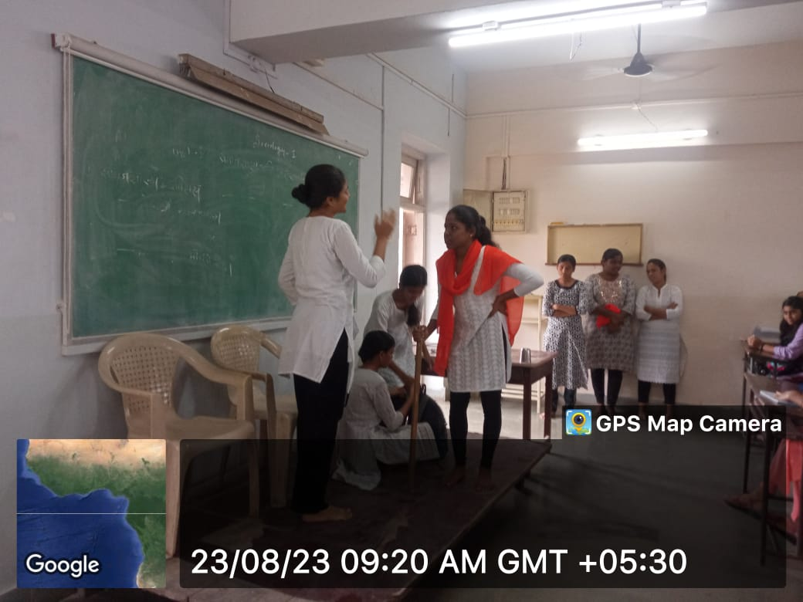
SENSITIZATION DRIVE

Slide 4
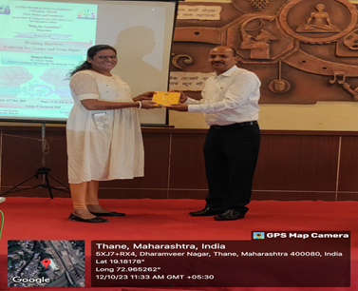
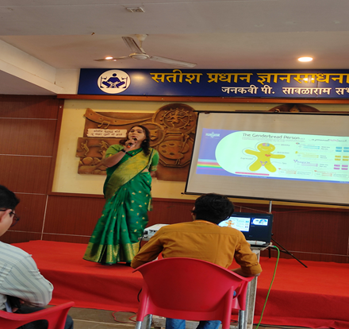
Breaking Barriers: Exploring Sex, Gender and
Trans Rights

Slide 5
PRECURSOR CONFERENCE MEET

Slide 6
New Year Celebration: Exploring Family Heritage with Grandparents

Slide 7
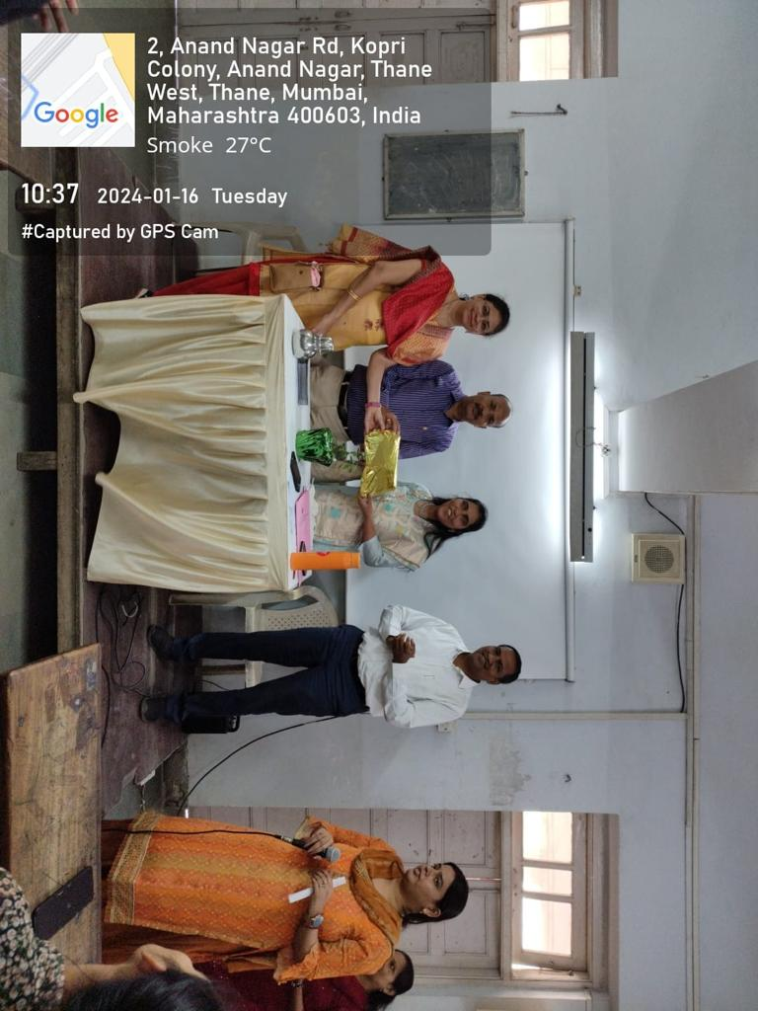
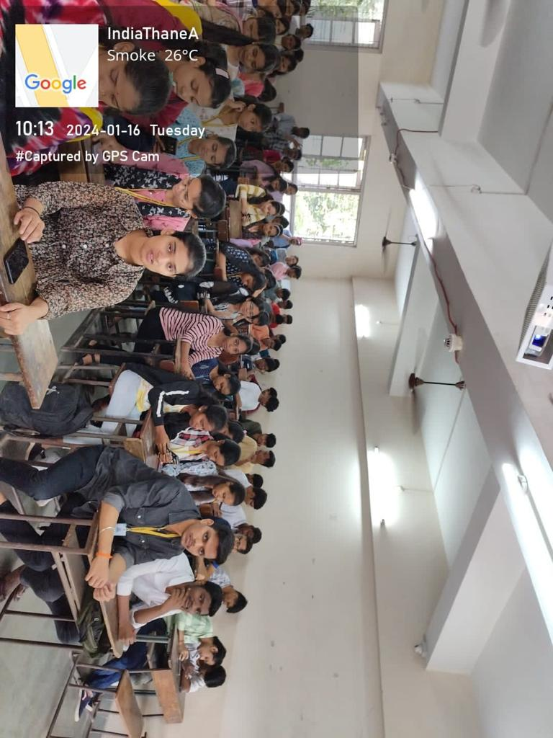
Navigating the World Beyond Constraints

Slide 8
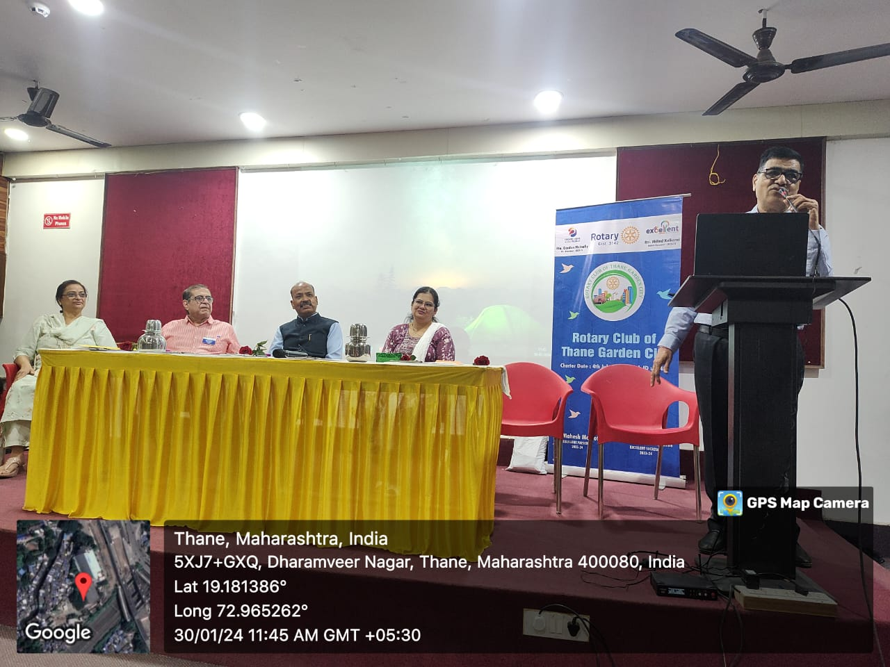
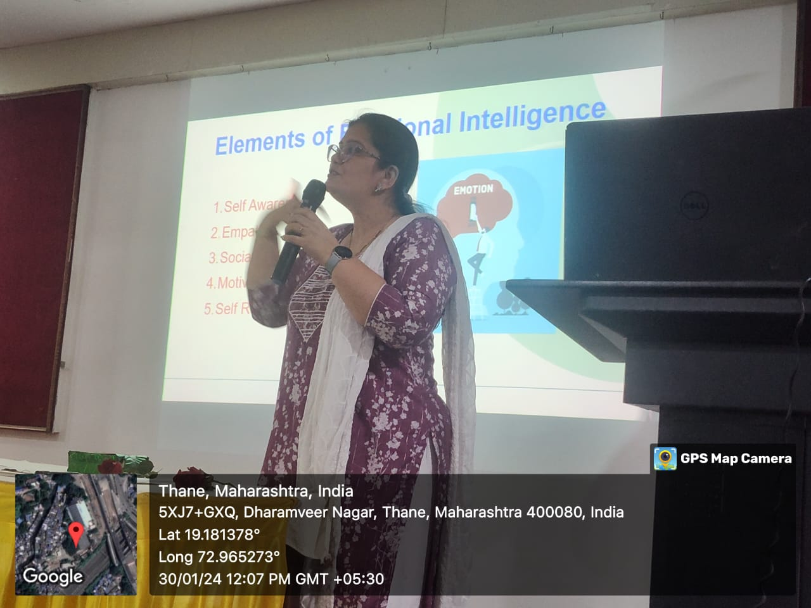
Expert Lecture on “Mental Well Being- Emotional Intelligence.”

Slide 9
BEING ME :CONFERENCE

Slide 10
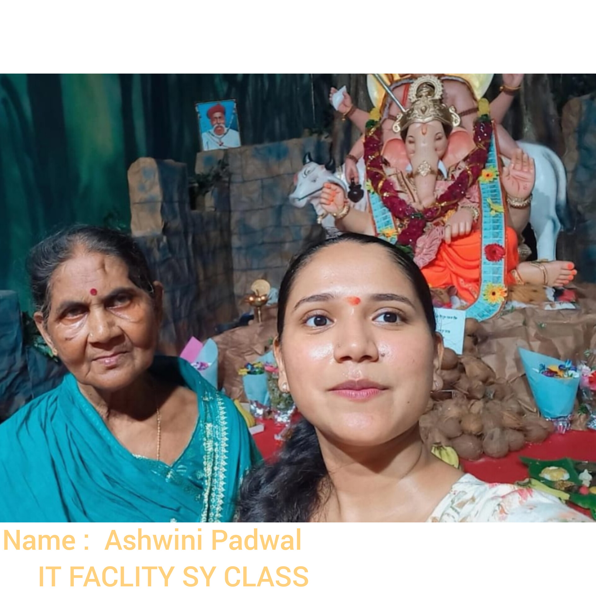
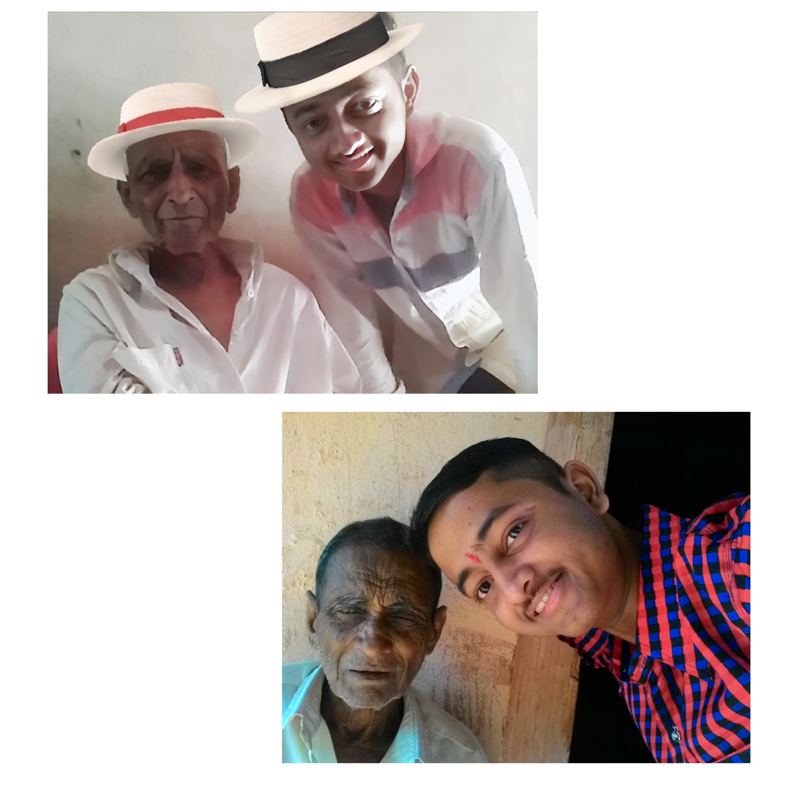
Ek Selfie Tho Banta Hai

